Slide 1
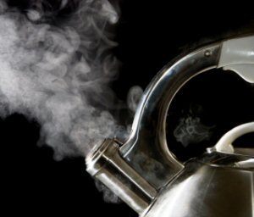
Introduction to Thermodynamics
Dr. Joseph Daniel
Associate Professor
SMBS
Vellore Institute of Technology
Chennai Campus

Slide 4
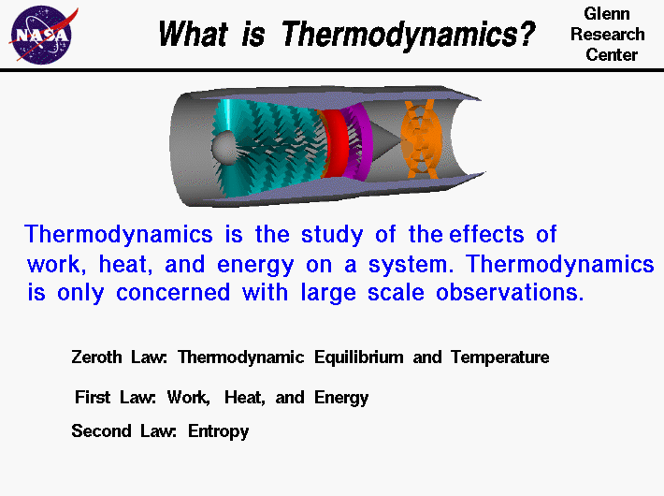

Slide 5
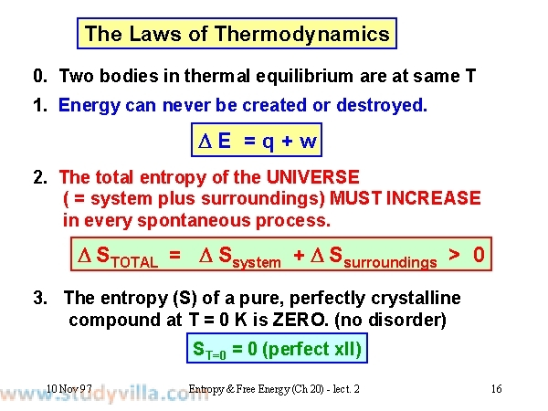

Slide 6
Philosophical Significance
Zeroth Law : Equilibrium Existentialism
First Law: Conservational transformationalism
Second Law: Forced Directional, irreversible transformationalism
Third Law: Unattainability of Emptyness

Slide 7
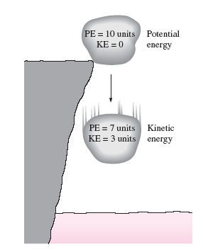
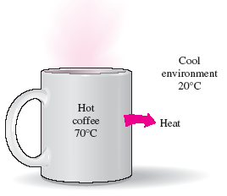
First and Second Law illustrations

Slide 8
Preliminaries
The word Thermo-Dynamics was used by Thomson, it has greek origin
Combination of Heat and Power
Three off shoots namely Classical and statistical thermodynamics and chemical thermodynamics
Classical thermodynamics does not take into consideration the molecular nature of matter and quantum mechanical effects
Is not completely ignored but lumped into simple models
In general a definition to thermodynamics can be given like this “ it’s the science that deals with heat and work and those properties of matter that relates to heat and work.

Slide 9
Areas of Thermodynamics
Engines
Phase transitions
Chemical Reactions
Transport phenomena
Black holes
Physics and Chemistry
Aerospace Engineering
Cell Biology
Biomedical Engineering
Material science.

Slide 10
The Classification-Classical TD
Classical Thermodynamics: It does not take into consideration the molecular nature of matter and quantum mechanical effects.
Description of states and processes using macroscopic and empirical properties directly measurable in Laboratories
It is used to model exchanges of heat, work and matter based on certain postulates

Slide 11
The Classification-Statistical and Chemical TD
Developed in the second half of the 19th century due to the development of atomic and molecular theories.
This relates to the microscopic properties of individual atoms and molecules to macroscopic bulk properties of materials that can be observed on human scale.
It combines the essentials of statistics, quantum theory and classical mechanics.
Chemical TD:It is the study of the inter relation of energy with chemical reactions with physical change of states within the domain of thermodynamic principles

Slide 12
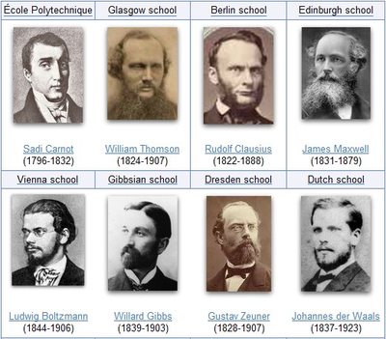
Famous Thermodynamicists

Slide 13
Historical Milestones
1st Century AD: Hero of Alexandria documented early thermal engines
1593: Galileo develops water thermometer
1662: Robert boyle develops laws for isothermal ideal gases.
1698: Early steam engine patented by Thomas Savery.
1710: Thomas Newcomen creates a more practical steam engine.
1780: James Watts suggests an improved steam engine
1824: Sadi carnot proposes idealized heat engines
1840: Henry Hess considers an early version of first law of TD

Slide 14
More Milestones
1840: Julius Robert Von Mayer and James Prescott Joule relates heat and work.
1847: Herman Von Helmholtz publishes his theory of Energy conservation.
1848: William Thomson (Lord Kelvin) proposes an absolute zero of temperature.
1850: Clausius formalizes second law of TD
1865: Clausius introduces the concept of Entropy.
1870: Josiah Willard Gibbs formalizes mathematical TD
1871: James Maxwell develops Maxwells relations
1889: Gibbs develops classical mechanics which led to the development of statistical TD

Slide 15
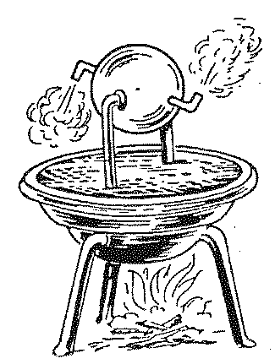
Early TD Machines
Hero’s Turbine

Slide 16
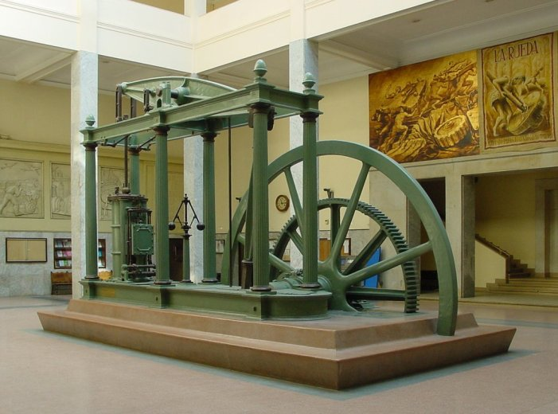
Latest Model Steam Engine of James Watt

Slide 17
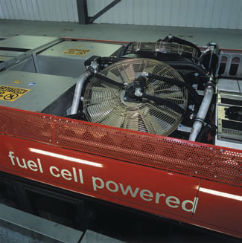
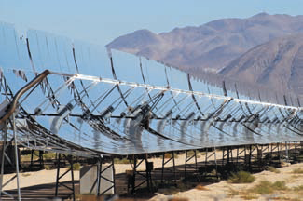
MODERN DAY ENERGY CONVERSION MACHINES
Parabolic Trough Concentrators
Fuel Cell based Transport systems

Slide 18
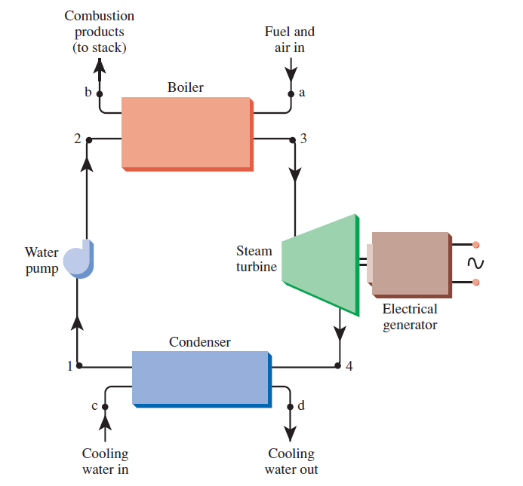
Some Practical Applications
Fossil Fueled Power plants

Slide 19
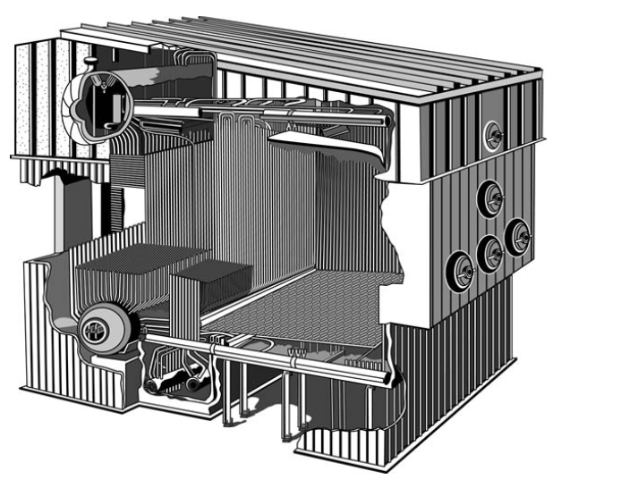
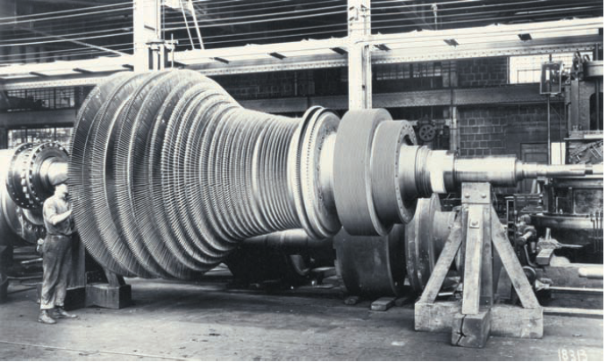
Westinghouse Steam turbine
Cut Section View of Boiler

Slide 20
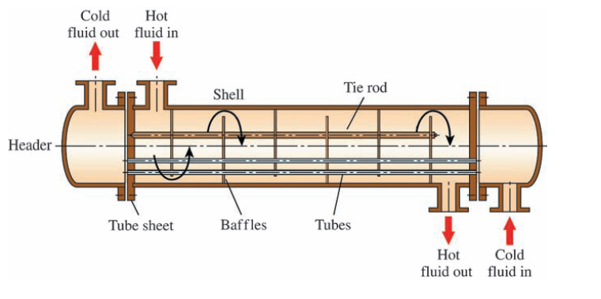
Heat Exchanger

Slide 21
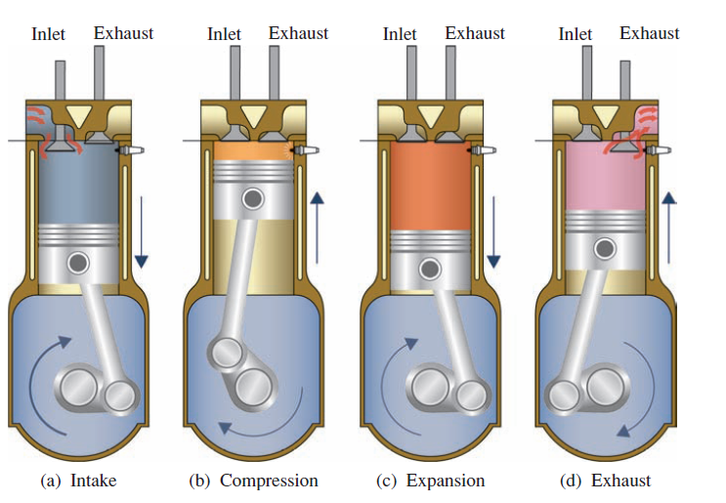
Spark Ignition 4S Engine

Slide 22
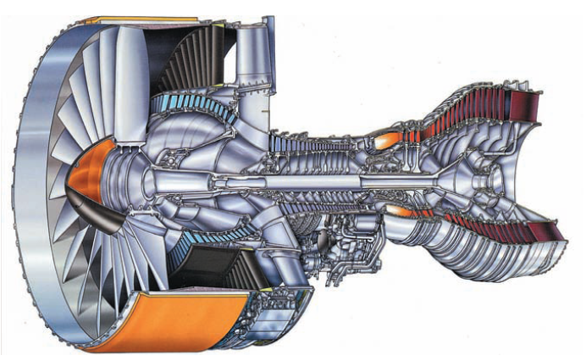
Turbofan Engines used in Airbus and Boeing Flights

Slide 23
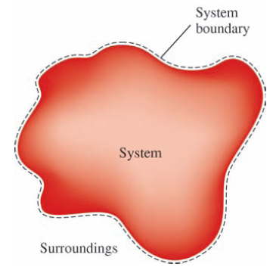
System and its types
A System in general is defined as anything we wish to analyze and distinguish from its surroundings and environment.
Also considered as a quantity of fixed mass in consideration.
Surroundings are everything external to the system
System boundary is the interface separating system and the surroundings.
Universe puts together the system and the surroundings.

Slide 24
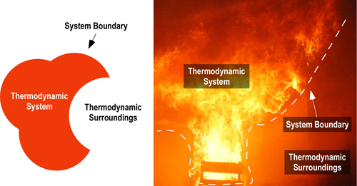
Illustration of boundary, system and surroundings

Slide 25
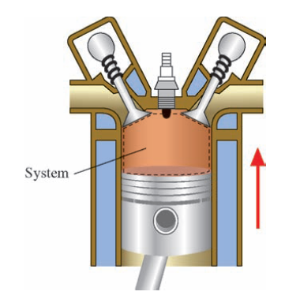
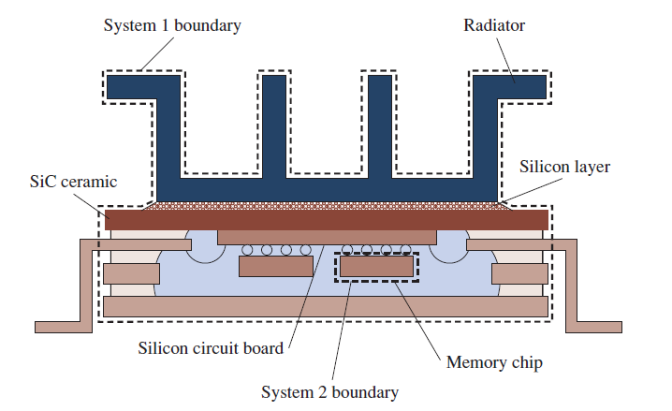
Real time examples of systems

Slide 26
Systems and its classification
Some thoughts about system
A system boundary can be either fixed or movable.
System boundary is the contact surface shared by both system and the surroundings
System boundary has neither mass nor occupy any volume in space.
Boundary has zero thickness.

Slide 27
A closed system: consists about fixed amount of mass and no other mass can neither enter nor leave the system. But energy can do the crossing over
An Isolated system is the one in which both mass and energy crossing over is banned.
An Open system or a control volume: Involves mass flow in and out and both mass and energy can cross over the system boundary.
Eg: compressor, turbines and fans

Slide 28
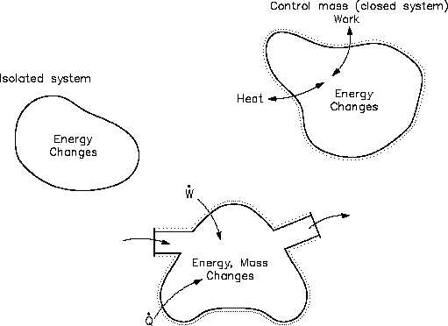
Diagrammatic approach

Slide 29
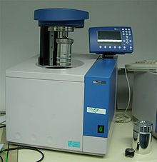
Examples of Closed system
Cylinder with movable piston: Gas can receive or reject heat, expand or contract based on piston movement (inward or outward) but gas never crosses the system
Bomb Calorimeter: Electrical energy crosses the boundary to cause a spark between electrodes and initiate combustion.
Motor car battery: No mass transfer
Fluid power systems

Slide 30
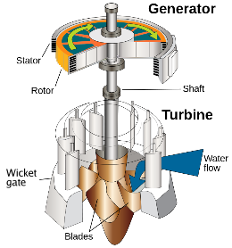
Examples of Open system
Water wheel or a hydraulic turbine: Converts the Potential energy of water to mechanical work. Mass crosses the system. The work output due to rotation of the wheel also crosses the system boundary
Steam generation in Boiler

Slide 31
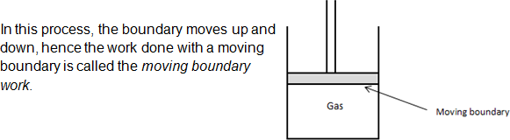
Closed system with moving boundary

Slide 32
Adiabatic system
The walls do not permit heat transfer to take place
It is thermally insulated from the environment
Can exchange energy in the form of work only

Slide 33
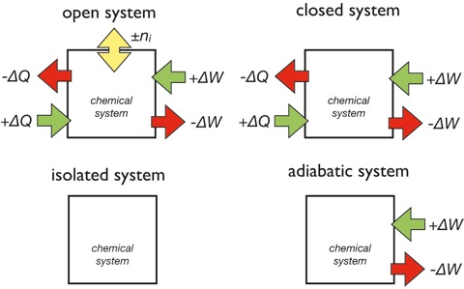
Isolated system
Fixed mass and energy
Exchanges neither mass nor energy with surroundings
Has no interaction with the surroundings
Neither influences it nor is influenced by the surroundings

Slide 34
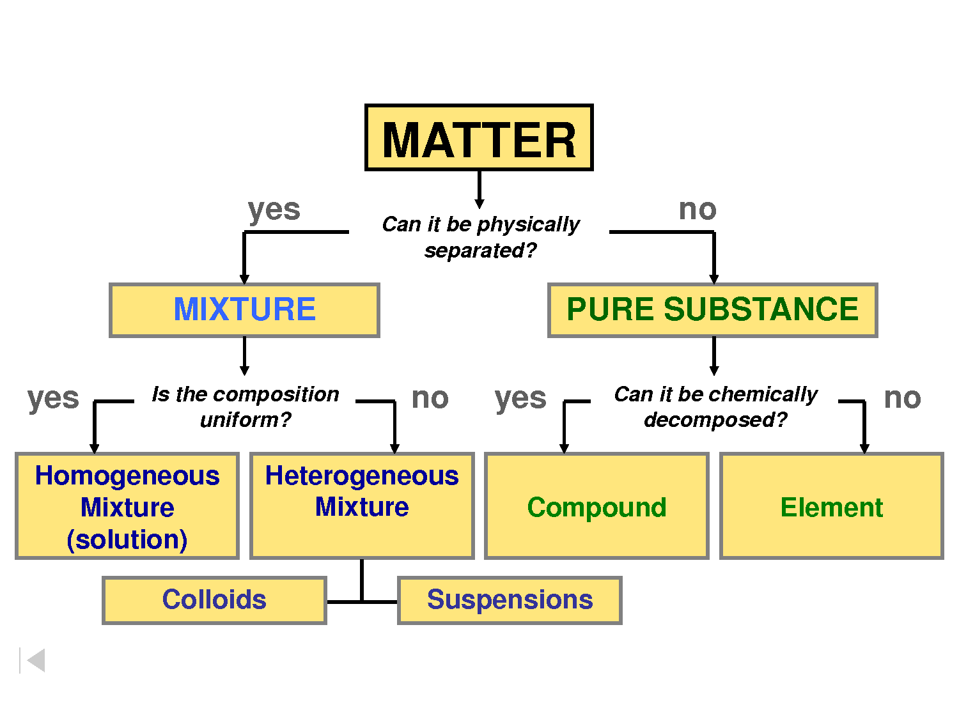
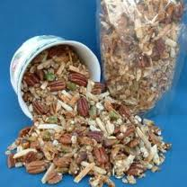
Homogeneous and Heterogeneous systems
Phase: represents a quantity of matter that is uniform throughout in physical structure and in chemical composition.
Physical uniformity: matter is all gas, liquid, solid etc
Chemical uniformity: chemical composition does not vary from one part of the system to the another.
Eg: Homogeneous- ice, water, dry steam etc
- Mix of ammonia in water
- Air+water vapor.
Heterogeneous- Mixture of ice and water
- Water and petrol

